Slide 1
Basic Electric Circuits
Thevenin’s and Norton’s
Theorems
Lesson 10

Slide 2
THEVENIN & NORTON
THEVENIN’S THEOREM:
Consider the following:
A
•
Network
1
Network
2
B
•
Figure 10.1: Coupled networks.
For purposes of discussion, at this point, we consider
that both networks are composed of resistors and
independent voltage and current sources
1

Slide 3
THEVENIN & NORTON
THEVENIN’S THEOREM:
Suppose Network 2 is detached from Network 1 and
we focus temporarily only on Network 1.
•
A
Network
1
•
B
Figure 10.2: Network 1, open-circuited.
Network 1 can be as complicated in structure as one
can imagine. Maybe 45 meshes, 387 resistors, 91
voltage sources and 39 current sources.
2

Slide 4
THEVENIN & NORTON
THEVENIN’S THEOREM:
•
A
Network
1
•
B
Now place a voltmeter across terminals A-B and
read the voltage. We call this the open-circuit voltage.
No matter how complicated Network 1 is, we read one
voltage. It is either positive at A, (with respect to B)
or negative at A.
We call this voltage V_{os} and we also call it V_{THEVENIN} = V_{TH}
3

Slide 5
THEVENIN & NORTON
THEVENIN’S THEOREM:
We now deactivate all sources of Network 1.
To deactivate a voltage source, we remove
the source and replace it with a short circuit.
To deactivate a current source, we remove
the source.
4

Slide 6
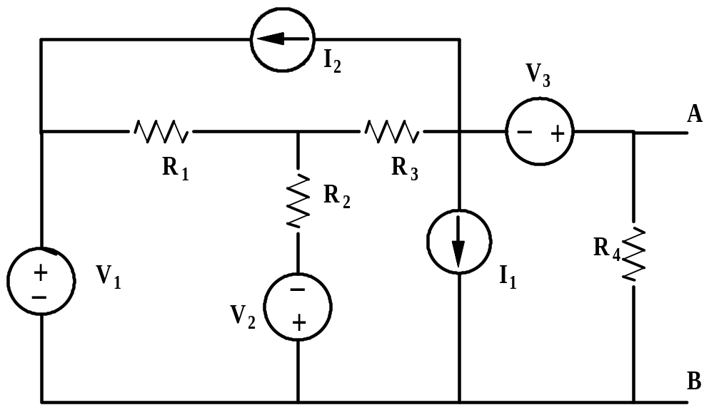
THEVENIN & NORTON
THEVENIN’S THEOREM:
Consider the following circuit.
Figure 10.3: A typical circuit with independent sources
How do we deactivate the sources of this circuit?
5

Slide 7
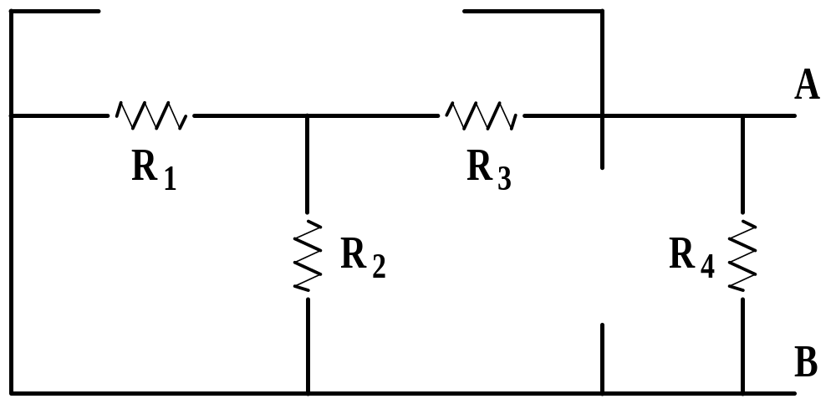
THEVENIN & NORTON
THEVENIN’S THEOREM:
When the sources are deactivated the circuit appears
as in Figure 10.4.
Figure 10.4: Circuit of Figure 10.3 with sources deactivated
Now place an ohmmeter across A-B and read the resistance.
If R₁= R₂ = R₄= 20 Ω and R₃=10 Ω then the meter reads 10 Ω.
6

Slide 8
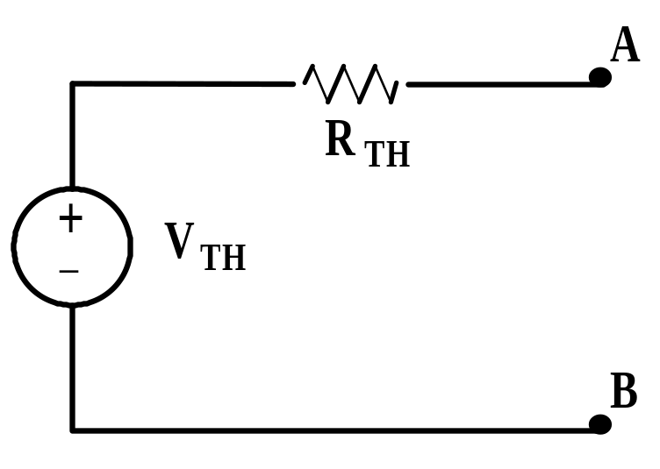
THEVENIN & NORTON
THEVENIN’S THEOREM:
We call the ohmmeter reading, under these conditions,
R_{THEVENIN} and shorten this to R_{TH}. Therefore, the
important results are that we can replace Network 1
with the following network.
Figure 10.5: The Thevenin equivalent structure.
7

Slide 9
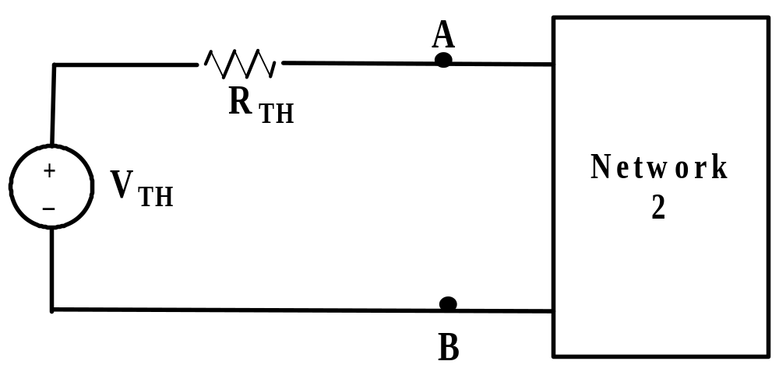
THEVENIN & NORTON
THEVENIN’S THEOREM:
We can now tie (reconnect) Network 2 back to
terminals A-B.
Figure 10.6: System of Figure 10.1 with Network 1
replaced by the Thevenin equivalent circuit.
We can now make any calculations we desire within
Network 2 and they will give the same results as if we
still had Network 1 connected.
8

Slide 10
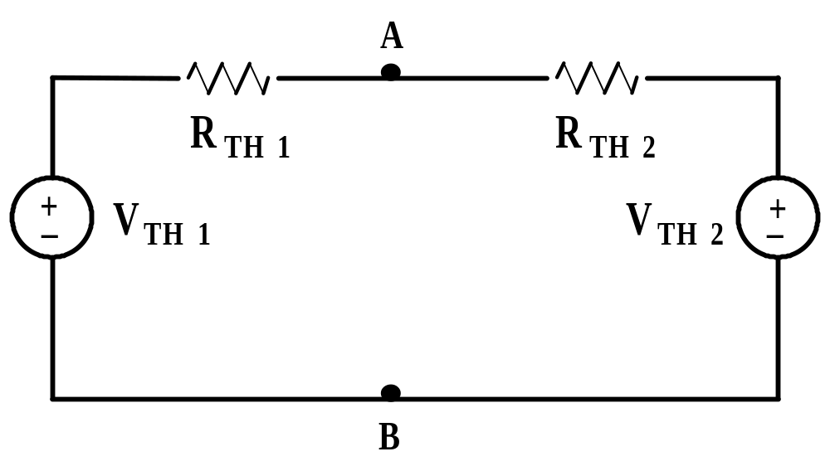
THEVENIN & NORTON
THEVENIN’S THEOREM:
It follows that we could also replace Network 2 with a
Thevenin voltage and Thevenin resistance. The results
would be as shown in Figure 10.7.
Figure 10.7: The network system of Figure 10.1
replaced by Thevenin voltages and resistances.
9

Slide 11
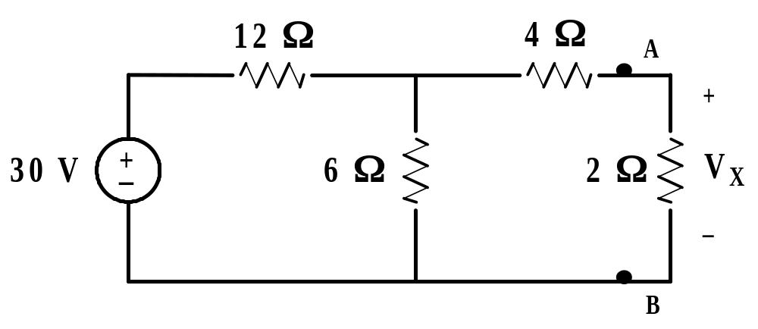
THEVENIN & NORTON
THEVENIN’S THEOREM: Example 10.1.
Find V_{X} by first finding V_{TH} and R_{TH} to the left of A-B.
Figure 10.8: Circuit for Example 10.1.
First remove everything to the right of A-B.
10

Slide 12
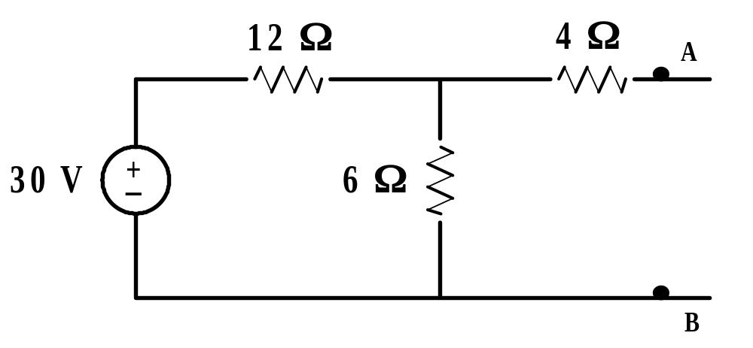
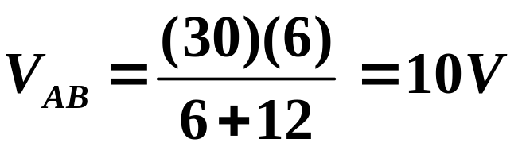
THEVENIN & NORTON
THEVENIN’S THEOREM: Example 10.1. continued
Figure 10.9: Circuit for finding V_{TH} for Example 10.1.
Notice that there is no current flowing in the 4 Ω resistor
(A-B) is open. Thus there can be no voltage across the
resistor.
11

Slide 13
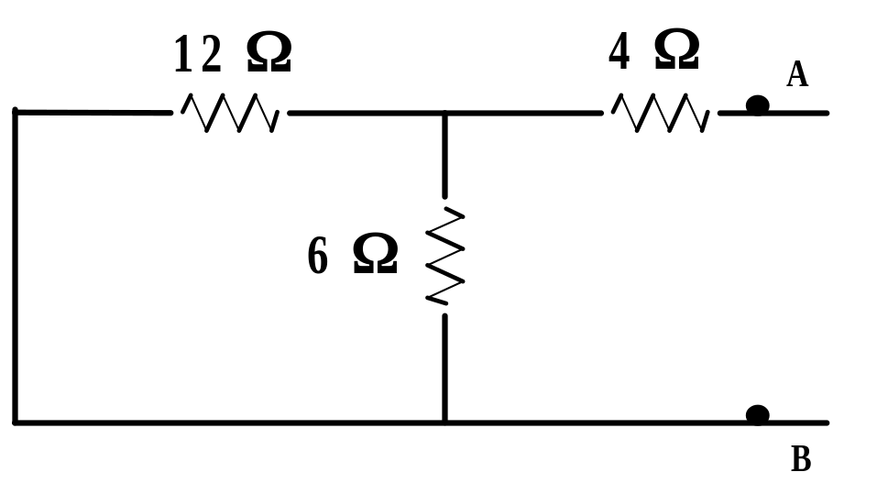
THEVENIN & NORTON
THEVENIN’S THEOREM: Example 10.1. continued
We now deactivate the sources to the left of A-B and find
the resistance seen looking in these terminals.
R_{TH}
Figure 10.10: Circuit for find R_{TH} for Example 10.10.
We see,
R_{TH} = 12||6 + 4 = 8 Ω
12

Slide 14
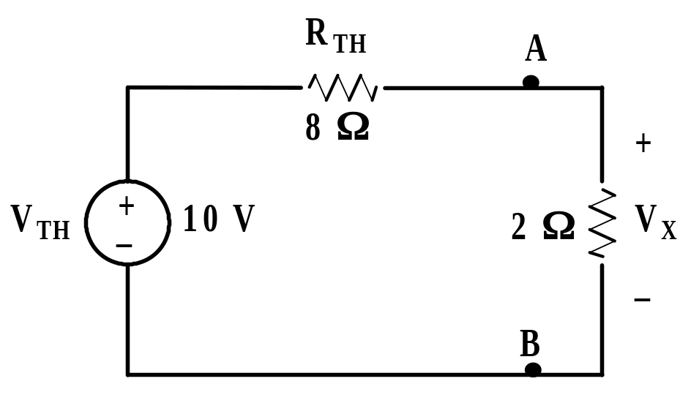
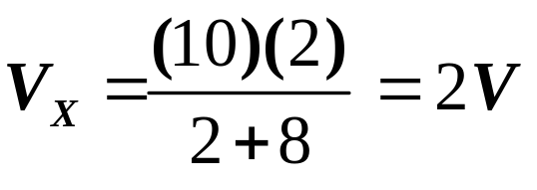
THEVENIN & NORTON
THEVENIN’S THEOREM: Example 10.1. continued
After having found the Thevenin circuit, we connect this
to the load in order to find V_{X}.
Figure 10.11: Circuit of Ex 10.1 after connecting Thevenin
circuit.
13

Slide 15
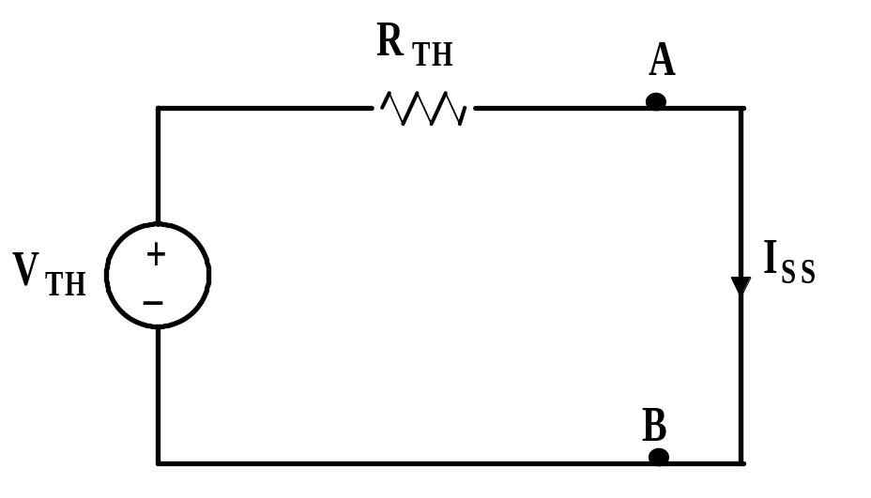
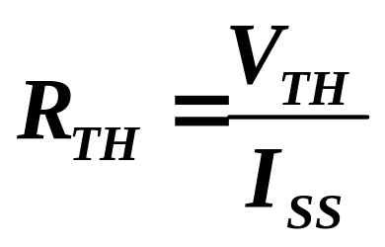
THEVENIN & NORTON
THEVENIN’S THEOREM:
In some cases it may become tedious to find R_{TH} by reducing
the resistive network with the sources deactivated. Consider
the following:
Figure 10.12: A Thevenin circuit with the output shorted.
We see;
Eq 10.1
14

Slide 16
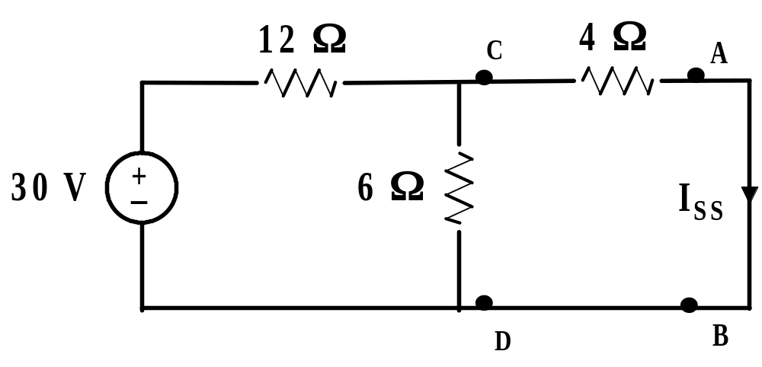
THEVENIN & NORTON
THEVENIN’S THEOREM: Example 10.2.
For the circuit in Figure 10.13, find R_{TH} by using Eq 10.1.
Figure 10.13: Given circuit with load shorted
The task now is to find I_{SS}. One way to do this is to replace
the circuit to the left of C-D with a Thevenin voltage and
Thevenin resistance.
15

Slide 17
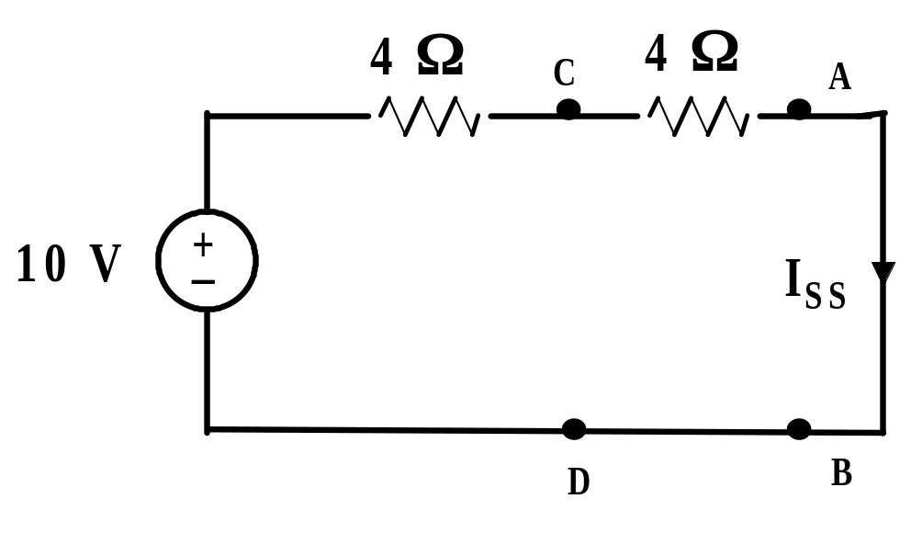
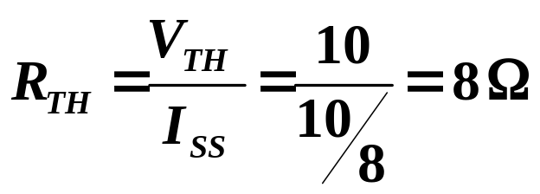
THEVENIN & NORTON
THEVENIN’S THEOREM: Example 10.2. continued
Applying Thevenin’s theorem to the left of terminals C-D
and reconnecting to the load gives,
Figure 10.14: Thevenin reduction for Example 10.2.
16

Slide 18
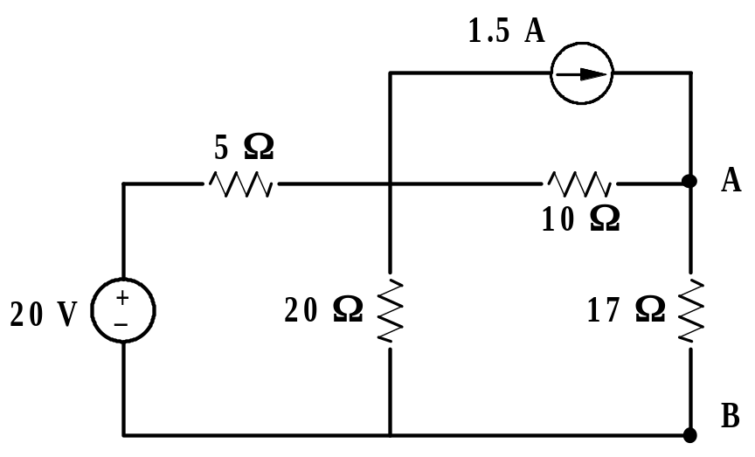
THEVENIN & NORTON
THEVENIN’S THEOREM: Example 10.3
For the circuit below, find V_{AB} by first finding the Thevenin
circuit to the left of terminals A-B.
Figure 10.15: Circuit for Example 10.3.
We first find V_{TH} with the 17 Ω resistor removed.
Next we find R_{TH} by looking into terminals A-B
with the sources deactivated.
17

Slide 19
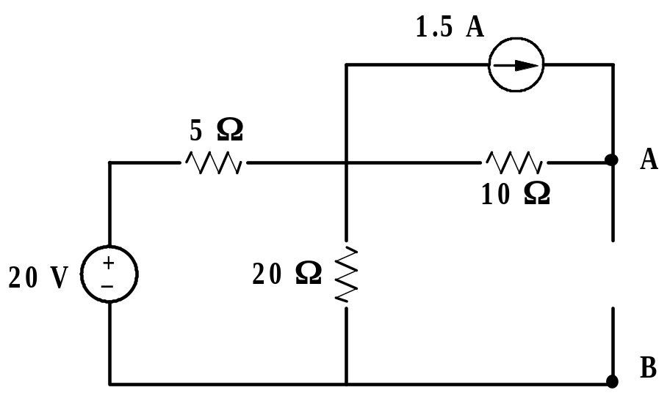
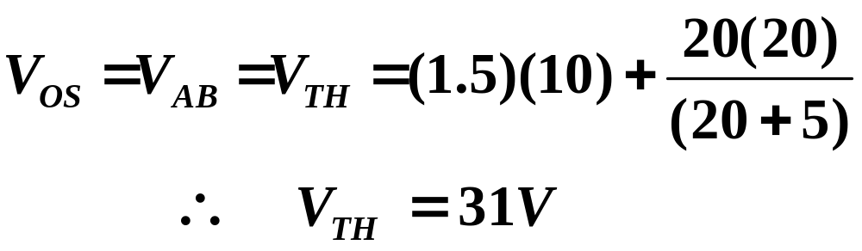
THEVENIN & NORTON
THEVENIN’S THEOREM: Example 10.3 continued
Figure 10.16: Circuit for finding V_{OC} for Example 10.3.
18

Slide 20
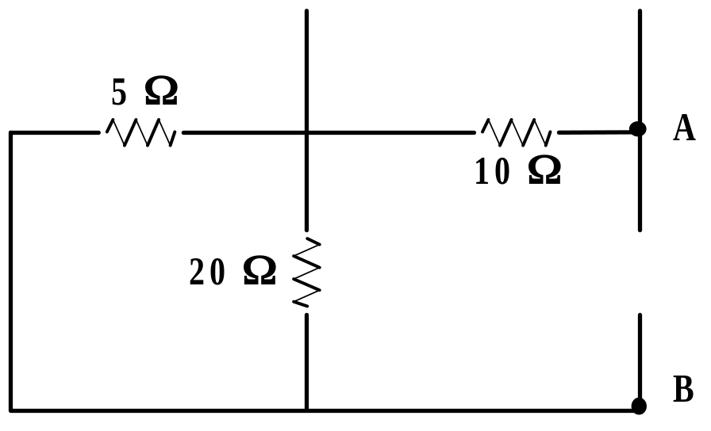
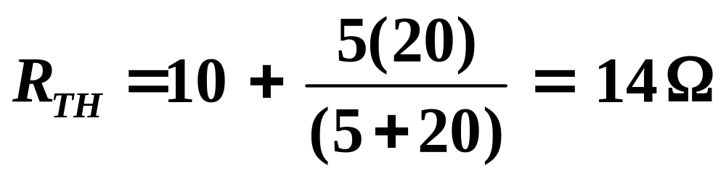
THEVENIN & NORTON
THEVENIN’S THEOREM: Example 10.3 continued
Figure 10.17: Circuit for find R_{TH} for Example 10.3.
19

Slide 21
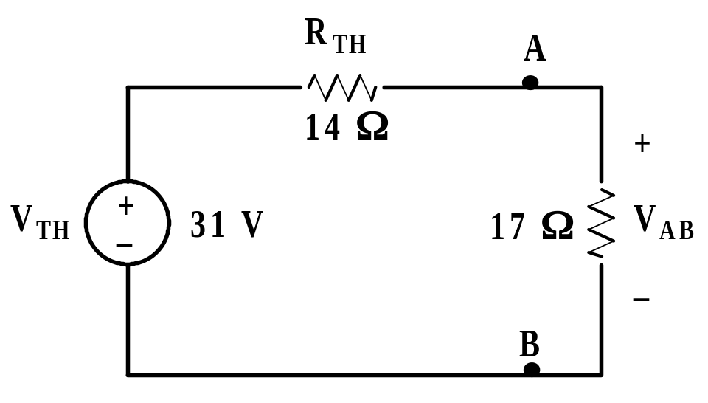
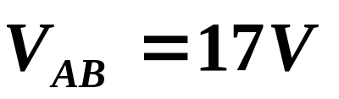
THEVENIN & NORTON
THEVENIN’S THEOREM: Example 10.3 continued
Figure 10.18: Thevenin reduced circuit for Example 10.3.
We can easily find that,
20

Slide 22
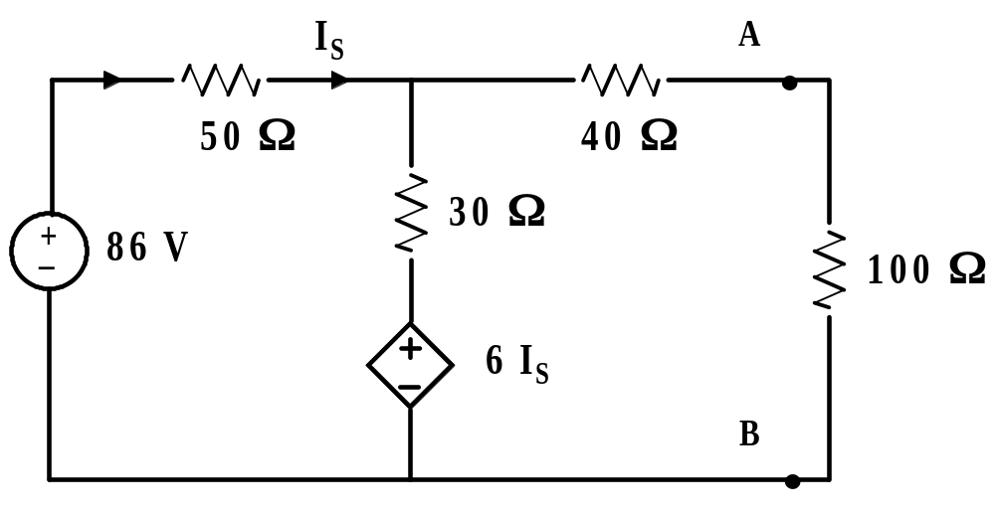
THEVENIN & NORTON
THEVENIN’S THEOREM: Example 10.4: Working
with a mix of independent and dependent sources.
Find the voltage across the 100 Ω load resistor by first finding
the Thevenin circuit to the left of terminals A-B.
Figure 10.19: Circuit for Example 10.4
21

Slide 23
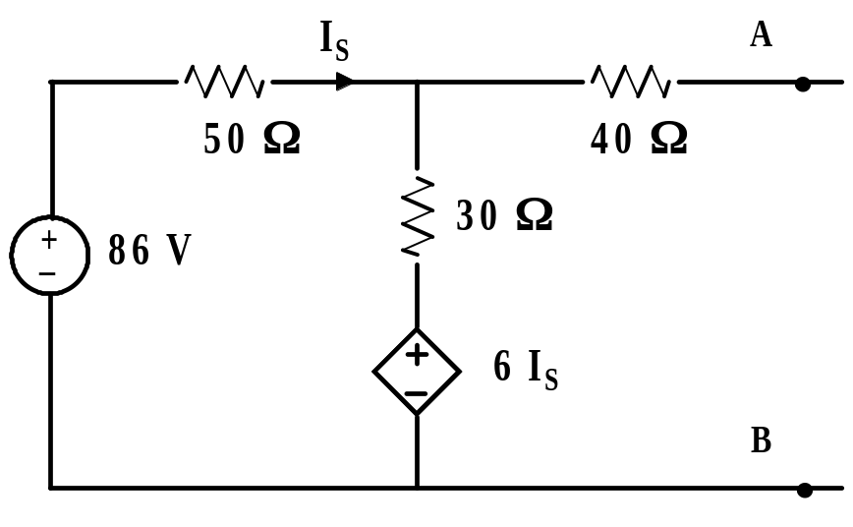
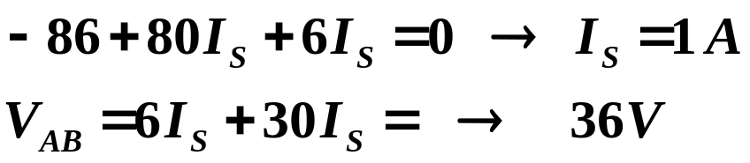
THEVENIN & NORTON
THEVENIN’S THEOREM: Example 10.4: continued
First remove the 100 Ω load resistor and find V_{AB} = V_{TH} to
the left of terminals A-B.
Figure 10.20: Circuit for find V_{TH}, Example 10.4.
22

Slide 24
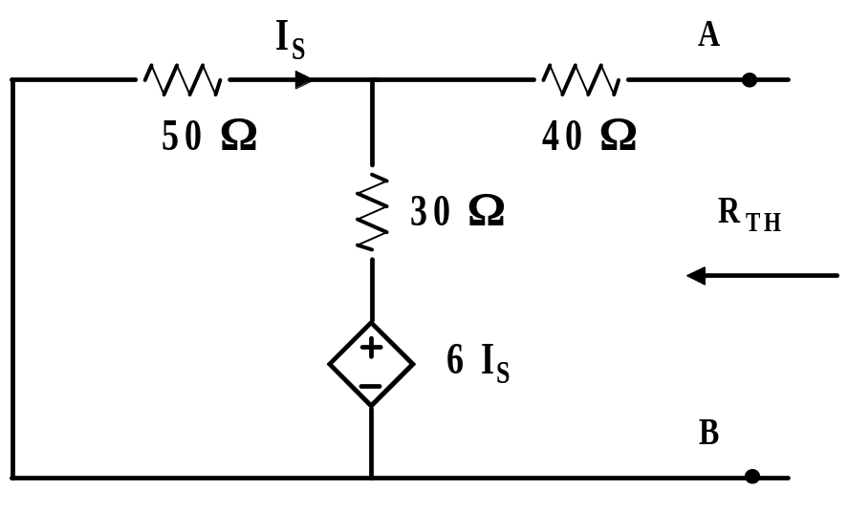
THEVENIN & NORTON
THEVENIN’S THEOREM: Example 10.4: continued
To find R_{TH} we deactivate all independent sources but retain
all dependent sources as shown in Figure 10.21.
Figure 10.21: Example 10.4, independent sources deactivated.
We cannot find R_{TH} of the above circuit, as it stands. We
must apply either a voltage or current source at the load
and calculate the ratio of this voltage to current to find R_{TH.}
23

Slide 25
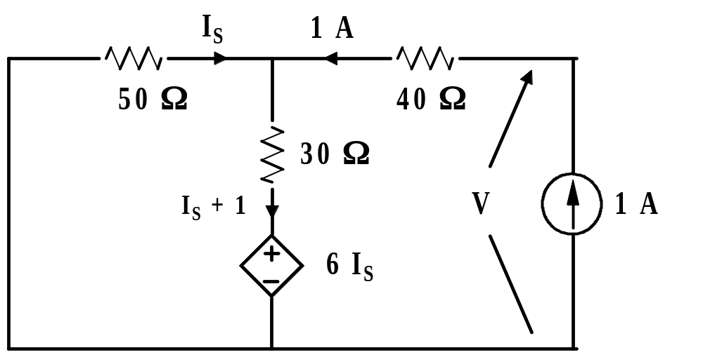
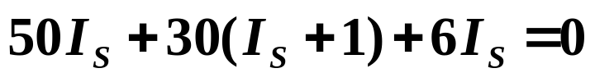
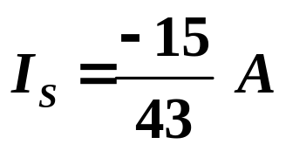
THEVENIN & NORTON
THEVENIN’S THEOREM: Example 10.4: continued
Figure 10.22: Circuit for find R_{TH}, Example 10.4.
Around the loop at the left we write the following equation:
From which
24

Slide 26
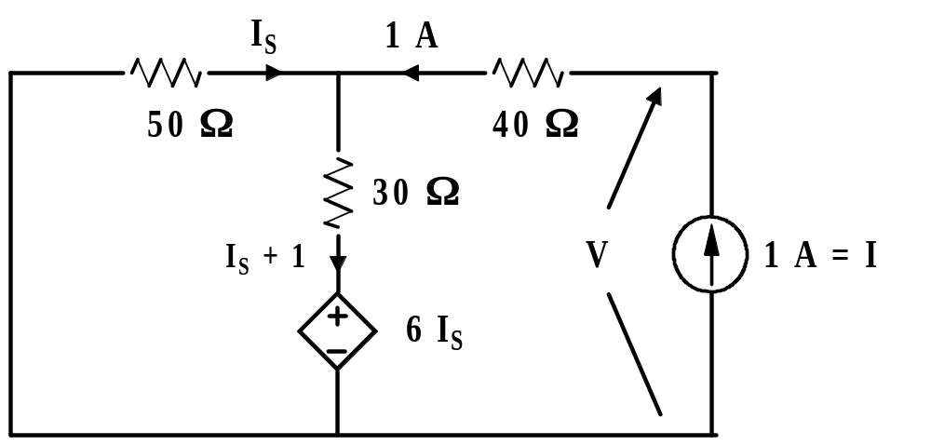
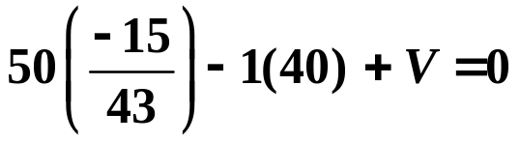

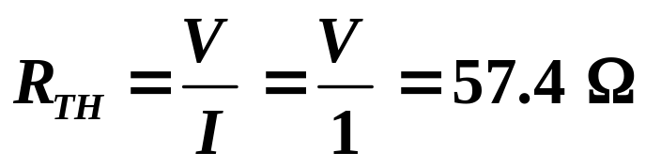
THEVENIN & NORTON
THEVENIN’S THEOREM: Example 10.4: continued
Figure 10.23: Circuit for find R_{TH}, Example 10.4.
Using the outer loop, going in the cw direction, using drops;
or
25

Slide 27
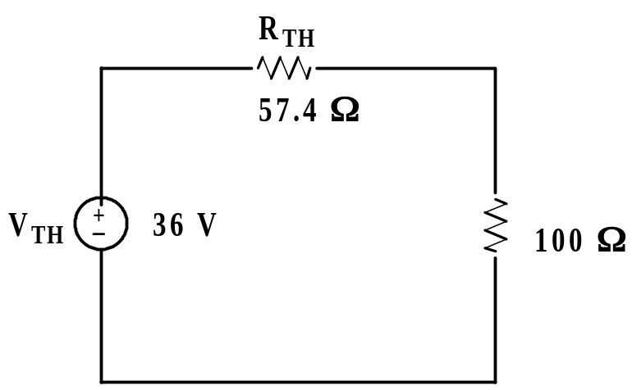
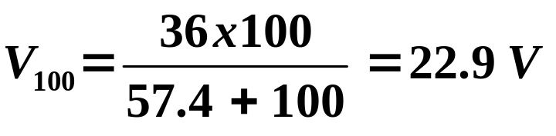
THEVENIN & NORTON
THEVENIN’S THEOREM: Example 10.4: continued
The Thevenin equivalent circuit tied to the 100 Ω load
resistor is shown below.
Figure 10.24: Thevenin circuit tied to load, Example 10.4.
26

Slide 28
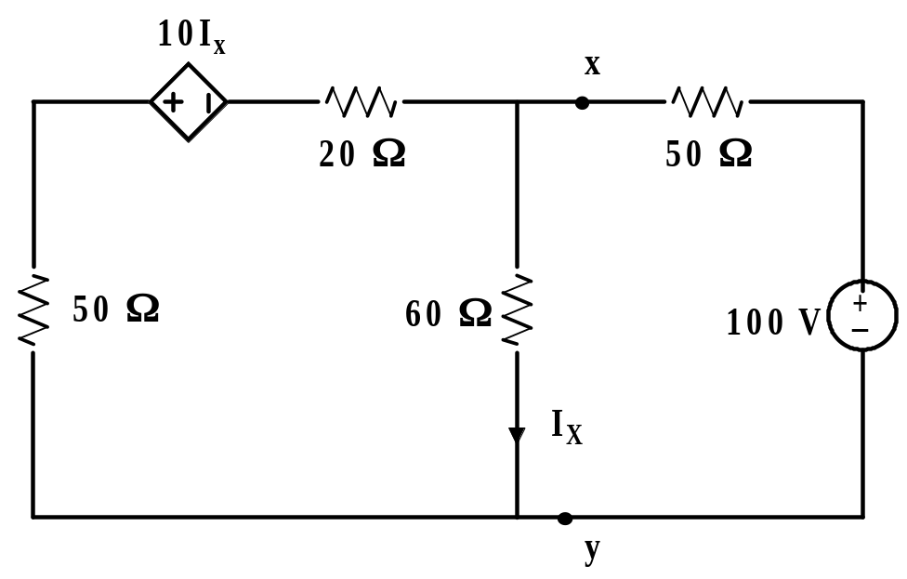
THEVENIN & NORTON
THEVENIN’S THEOREM: Example 10.5: Finding
the Thevenin circuit when only resistors and dependent
sources are present. Consider the circuit below. Find V_{xy}
by first finding the Thevenin circuit to the left of x-y.
Figure 10.25: Circuit for Example 10.5.
For this circuit, it would probably be easier to use mesh or nodal analysis to find V_{xy}. However, the purpose is to illustrate Thevenin’s theorem.
27

Slide 29
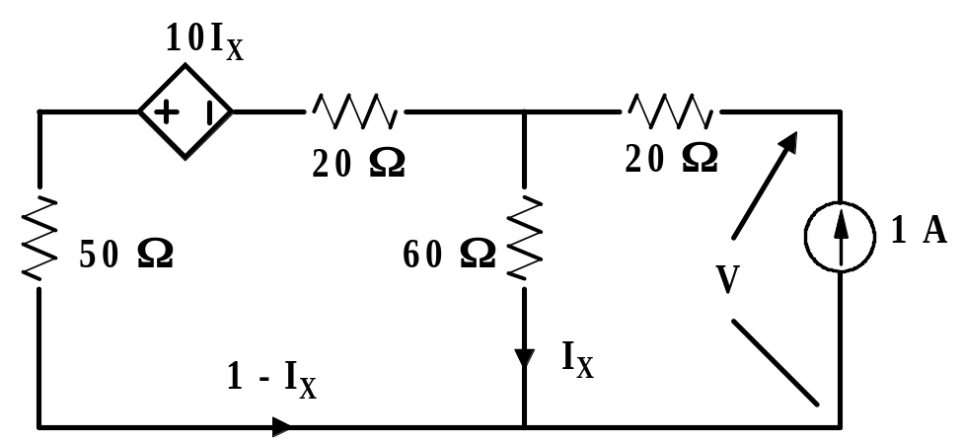
THEVENIN & NORTON
THEVENIN’S THEOREM: Example 10.5: continued
We first reconcile that the Thevenin voltage for this circuit
must be zero. There is no “juice” in the circuit so there cannot
be any open circuit voltage except zero. This is always true
when the circuit is made up of only dependent sources and
resistors.
To find R_{TH} we apply a 1 A source and determine V for
the circuit below.
Figure 10.26: Circuit for find R_{TH}, Example 10.5.

Slide 30
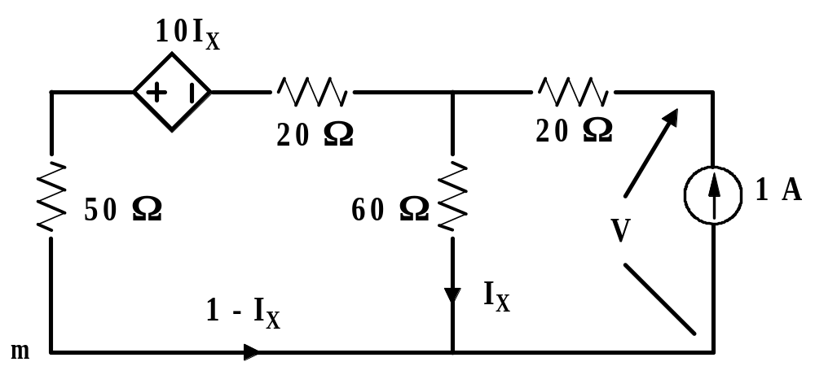

THEVENIN & NORTON
THEVENIN’S THEOREM: Example 10.5: continued
Figure 10.27: Circuit for find R_{TH}, Example 10.5.
Write KVL around the loop at the left, starting at “m”, going
cw, using drops:
29

Slide 31
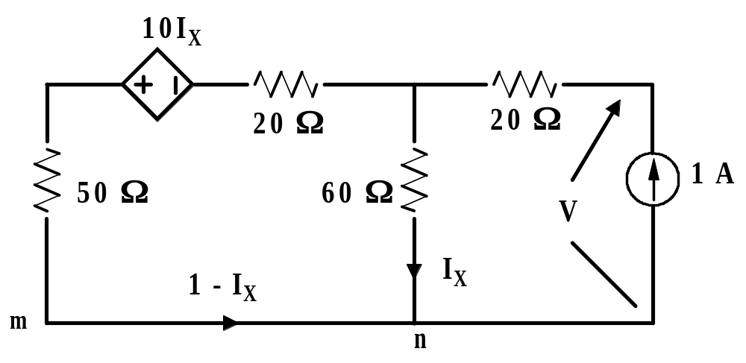
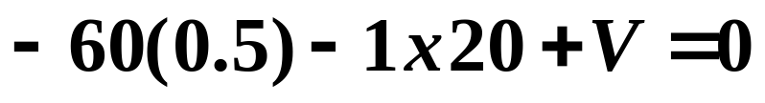
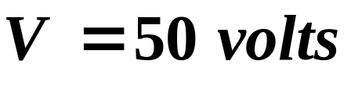
THEVENIN & NORTON
THEVENIN’S THEOREM: Example 10.5: continued
Figure 10.28: Determining R_{TH} for Example 10.5.
We write KVL for the loop to the right, starting at n, using
drops and find;
or

Slide 32
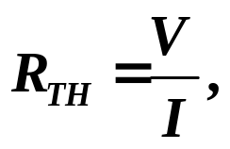
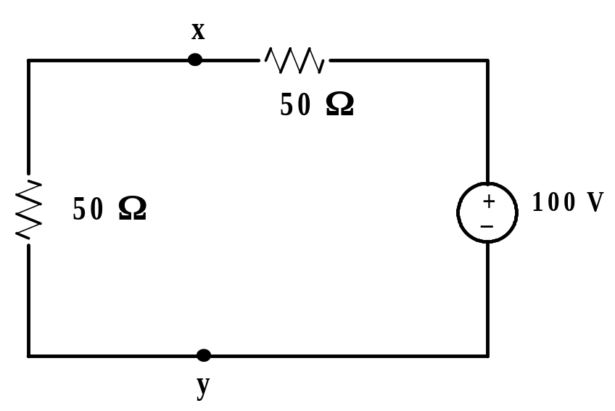
THEVENIN & NORTON
THEVENIN’S THEOREM: Example 10.5: continued
We know that,
where V = 50 and I = 1.
Thus, R_{TH} = 50 Ω. The Thevenin circuit tied to the
load is given below.
Figure 10.29: Thevenin circuit tied to the load, Example 10.5.
Obviously, V_{XY} = 50 V
31

Slide 33
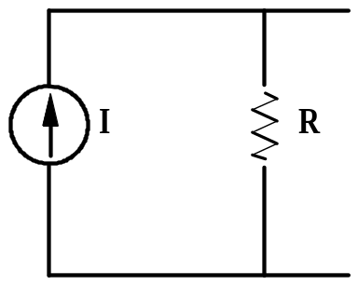
THEVENIN & NORTON
NORTON’S THEOREM:
Assume that the network enclosed below is composed
of independent sources and resistors.
Network
Norton’s Theorem states that this network can be
replaced by a current source shunted by a resistance R.
33

Slide 34
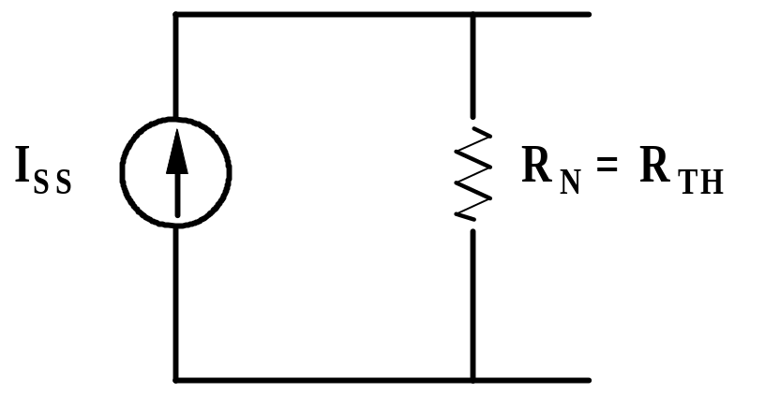
THEVENIN & NORTON
NORTON’S THEOREM:
In the Norton circuit, the current source is the short circuit
current of the network, that is, the current obtained by
shorting the output of the network. The resistance is the
resistance seen looking into the network with all sources
deactivated. This is the same as R_{TH}.

Slide 35
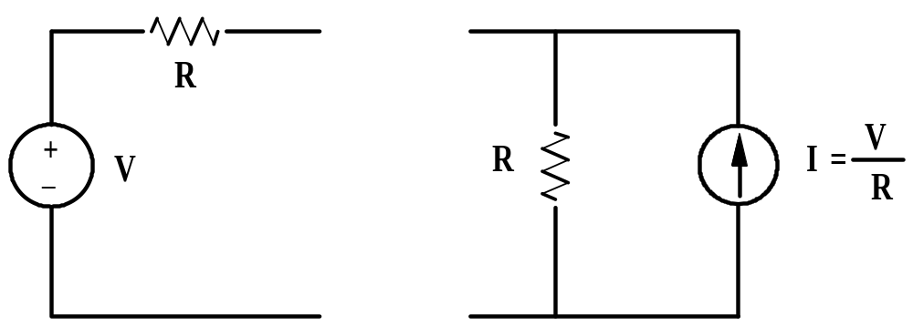
THEVENIN & NORTON
NORTON’S THEOREM:
We recall the following from source transformations.
In view of the above, if we have the Thevenin equivalent
circuit of a network, we can obtain the Norton equivalent
by using source transformation.
However, this is not how we normally go about finding
the Norton equivalent circuit.
34

Slide 36
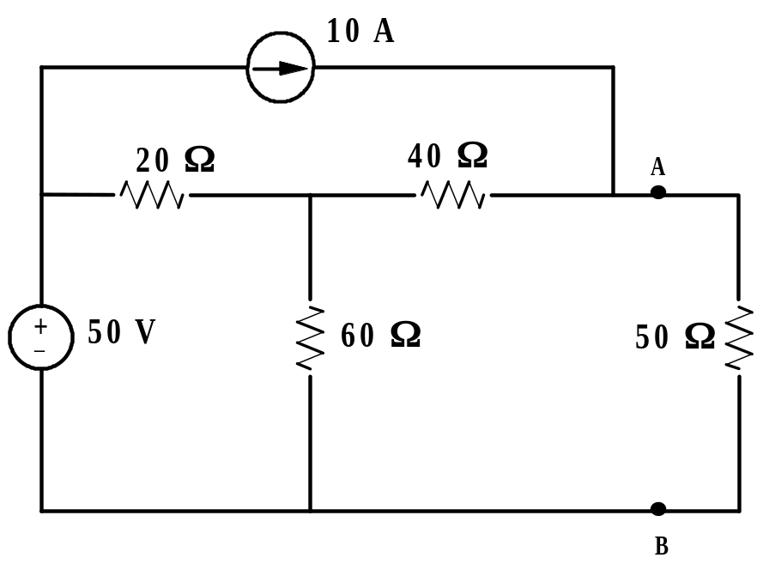
THEVENIN & NORTON
NORTON’S THEOREM: Example 10.6.
Find the Norton equivalent circuit to the left of terminals A-B
for the network shown below. Connect the Norton equivalent
circuit to the load and find the current in the 50 Ω resistor.
Figure 10.30: Circuit for Example 10.6.
35

Slide 37
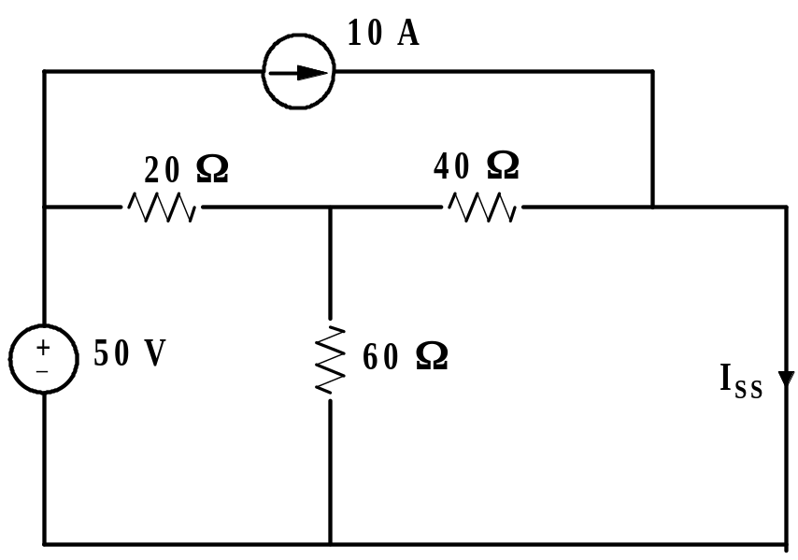
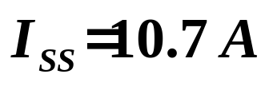
THEVENIN & NORTON
NORTON’S THEOREM: Example 10.6. continued
Figure 10.31: Circuit for find I_{NORTON}.
It can be shown by standard circuit analysis that
36

Slide 38
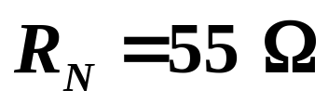

THEVENIN & NORTON
NORTON’S THEOREM: Example 10.6. continued
It can also be shown that by deactivating the sources,
We find the resistance looking into terminals A-B is
R_{N} and R_{TH} will always be the same value for a given circuit.
The Norton equivalent circuit tied to the load is shown below.
Figure 10.32: Final circuit for Example 10.6.
37

Slide 39

THEVENIN & NORTON
NORTON’S THEOREM: Example 10.7. This example
illustrates how one might use Norton’s Theorem in electronics.
the following circuit comes close to representing the model of a
transistor.
For the circuit shown below, find the Norton equivalent circuit
to the left of terminals A-B.
Figure 10.33: Circuit for Example 10.7.
38

Slide 40

THEVENIN & NORTON
NORTON’S THEOREM: Example 10.7. continued
We first find;
We first find V_{OS}:
39

Slide 41


THEVENIN & NORTON
NORTON’S THEOREM: Example 10.7. continued
Figure 10.34: Circuit for find I_{SS}, Example 10.7.
We note that I_{SS} = - 25I_{S}. Thus,
40

Slide 42


THEVENIN & NORTON
NORTON’S THEOREM: Example 10.7. continued
Figure 10.35: Circuit for find V_{OS}, Example 10.7.
From the mesh on the left we have;
From which,
41

Slide 43



THEVENIN & NORTON
NORTON’S THEOREM: Example 10.7. continued
We saw earlier that,
Therefore;
The Norton equivalent circuit is shown below.
Norton Circuit for Example 10.7
42

Slide 44

THEVENIN & NORTON
Extension of Example 10.7:
Using source transformations we know that the
Thevenin equivalent circuit is as follows:
Figure 10.36: Thevenin equivalent for Example 10.7.
43

Slide 45

circuits
End of Lesson 10
Thevenin and Norton

